Slide 1
A Presentation on solid waste management

Slide 2
Introduction
Solid waste is the solid and semi-solid material which is generated by various human activities , which is usually discarded as unwanted or useless.
Solid waste means any garbage, refuse, sludge and other discarded materials including solid, liquid, semi-solid, or contained gaseous material, resulting from industrial, commercial, mining and agricultural operations, and from community activities, but does not include solid or dissolved materials in domestic sewage, or solid or dissolved materials in irrigation return flows or industrial discharges.

Slide 3
Classification of solid waste
Food waste
Rubbish
Ashes and residue
Bulky waste
Street waste
Pathological waste
Construction waste
Industrial waste
Hazardous waste

Slide 4
Solid waste management(SWM)
Solid waste management (SWM) is one of the major environmental issues in cities of many developing countries, including Nepal.
Urban population growth and economic development lead to increasing generation of municipal solid waste (MSW).
The use of products that generate hazardous waste is another concern.
Unmanaged disposal of medical wastes from hospitals and clinics also contribute to pollution and public health hazards in the localities. Therefore, SWM has become a major concern for the municipalities of Nepal.

Slide 5
Cont..
The Government of Nepal enacted the Solid Waste Management Act of 2011 effective from 15 June 2011.
The objectives of the act include maintaining a clean and healthy environment by minimizing the adverse effects of solid waste on public health and the environment.
The local bodies, such as municipalities, have been made responsible for the construction, operation, and management of infrastructure for collection, treatment, and final disposal of MSW

Slide 6
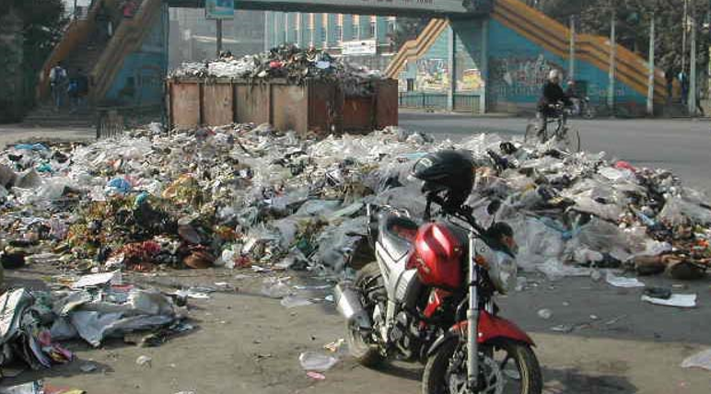
Poor waste management

Slide 7
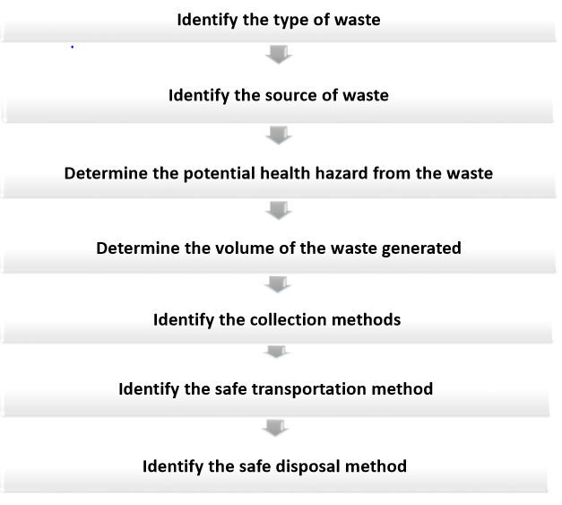
Procedure for SWM

Slide 8
Key component of SWM
GENERATION
STORAGE
COLLECTION
TRANSPORTATION
DISPOSAL

Slide 9
Solid waste management in kathmandu
In year 2013 A.D, the research carried out by Asian Development Bank, on solid waste management on various sector such as residential, commercial, and institutional, collected the data that conforms the material generates maximum and minimum waste.

Slide 10
Composition of household solid waste
Source: Asian Development Bank, 2013

Slide 11
composition of institutional solid waste
Wrong chart but data below is right
source: ADB,2013

Slide 12
Composition of commercial solid waste
Source: Asian Development Bank, 2013

Slide 13
Solid Waste Management Hierarchy
The hierarchy demonstrates how a material progress various stage of waste management, along with last section of life cycle of the same product.
The waste management hierarchy indicates a preference for the management and reduction of the waste.
Waste management hierarchy is important, as its purpose is to obtain highest amount of benefit from a product with lowest production of waste.
Waste management is needed to control the production of waste due to development work carried out through the nation

Slide 14
Source Reduction
Reuse
Land Filling
Recycling
Incineration

Slide 15
Cont..
Source reduction:
Reduction of source is also called waste prevention and its mean that wastage of things are reduced right at the source. The source can be reduced by changing the method of production, less use of packaging, reducing toxicity, donating thing for other purpose.

Slide 16
Cont..
Reuse:
Reusing the waste means the old material that is useless for the original purpose, is again used for other purpose. There are several advantages of this such as control of pollution, saving natural energy, and saving money.

Slide 17
Cont..
Recycle:
Recycling is one of such activity, which can involve various acts such as collection of those items which is considered as waste, sorting them according to their use, they can be used, reused, or unused, and then processing them into new raw material, out of which something new is manufactured. The benefit of recycling is energy saving, supplying raw material to industries, preventing the emission of green gases, and some other pollutant and even creation of several job.

Slide 18
Cont..
Incineration:
Although burning or incineration is often used for the disposal of combustible waste, this should generally only take place off-site or a considerable distance downwind of dwellings. Burning refuse within dwelling areas may create a significant smoke or fire hazard, especially if several fires are lit simultaneously. Burning may be used to reduce the volume of waste and may be appropriate where there is limited space for burial or landfill. Waste should be ignited within pits and covered with soil once incinerated, in the same manner as landfilling. The same constraints for siting landfill sites should be applied here also.
Advantages: Burning reduces volume of combustible waste considerably; and it is appropriate in off-site pits to reduce scavenging.
Constraints: There can be smoke or fire hazards.

Slide 19
Cont..
Landfilling:
Once solid waste is transported off-site it is normally taken to a landfill site. Here the waste is placed in a large excavation (pit or trench) in the ground, which is back-filled with excavated soil each day waste is tipped. Ideally, about 0.5m of soil should cover the deposited refuse at the end of each day to prevent animals from digging up the waste and flies from breeding. The location of landfill sites should be decided upon through consultation with the local authorities and the affected population. Sites should preferably be fenced, and at least one km downwind of the nearest dwellings.
Advantages: A sanitary disposal method if managed effectively.
Constraints: A reasonably large area is required.

Slide 20
conclusion
Thus the majority of solid waste produced in municipal areas is from residential sources and consists of majority of organic waste.
The waste management technique in majority on municipalities in Nepal are also not systematic and majority of them practices roadside picking and disposing in open area which causes major health problem.
Thus, proper characteristics of the solid waste produced should be recognized and systematic solid waste management technique should be established likewise.

Slide 21
Recommendation
Household waste and street waste should be collected regularly.
Landfill site and dumping site should be properly selected.
Hazardous waste should be separated and other should be recycled if possible.

Slide 22
Air pollution
Change in natural quality of air causing harmful effects on human beings and their environment
Air pollutants includes Particulate matter, gases and other radioactive substances
The concentration of pollutants rise above their background level
Sources of air pollutants- natural and anthropogenic
Rise of air pollutants level

Slide 23
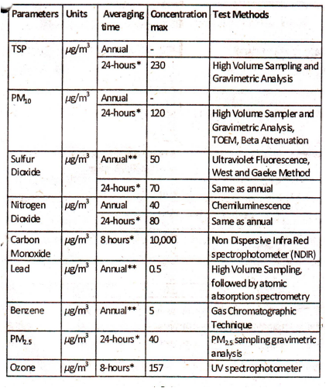
National Ambient Air Quality Standards, 2012

Slide 24
Pollution in Kathmandu Valley
Ambient Air Quality Monitoring System came in full operation from 2002
However not in full operation now
Six Permanent stations
Two road side Stations-Putalisadak and Patan
One Residential-Thamel
Two Urban Background-Bhaktapur and Kirtipur
One Valley Background-Machhegaun

Slide 25
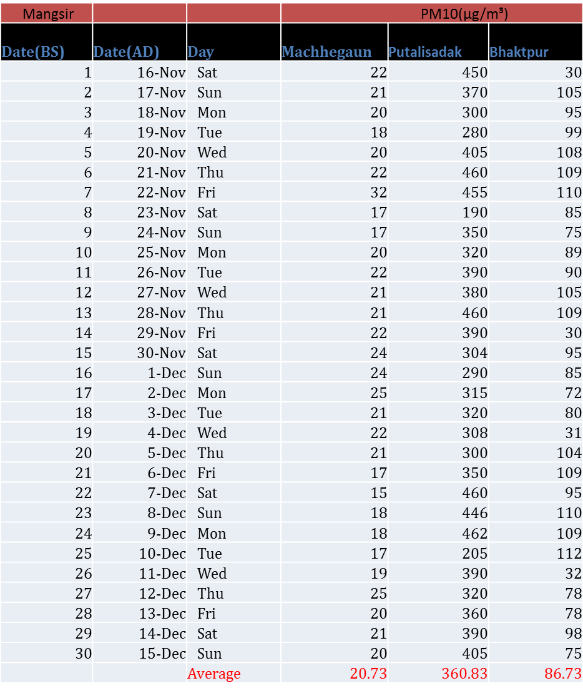
Pollutant concentration level (2070 B.S)

Slide 26
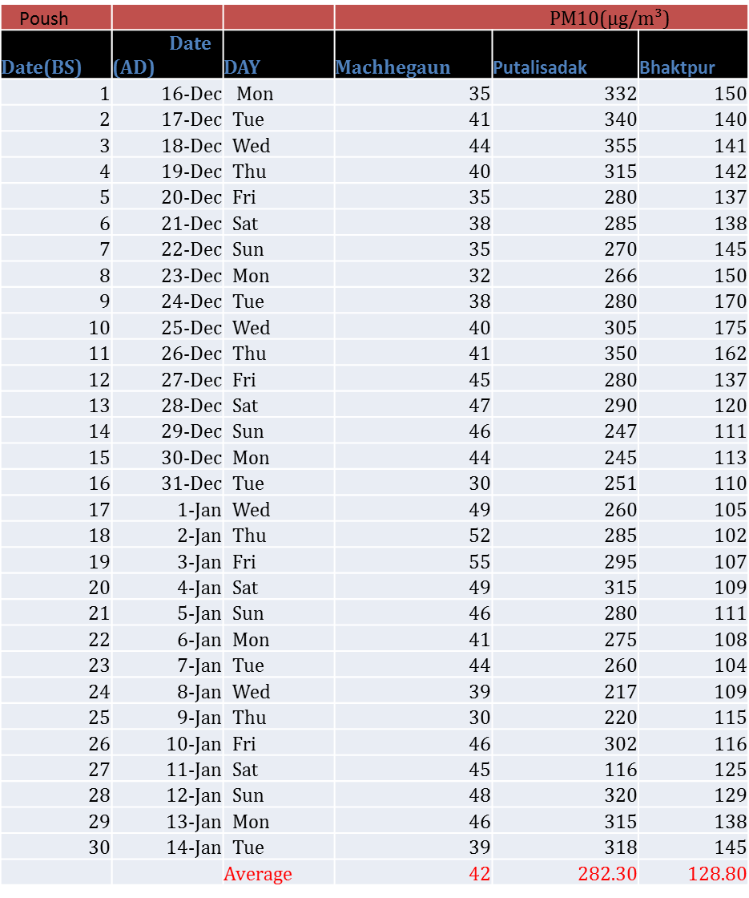

Slide 27
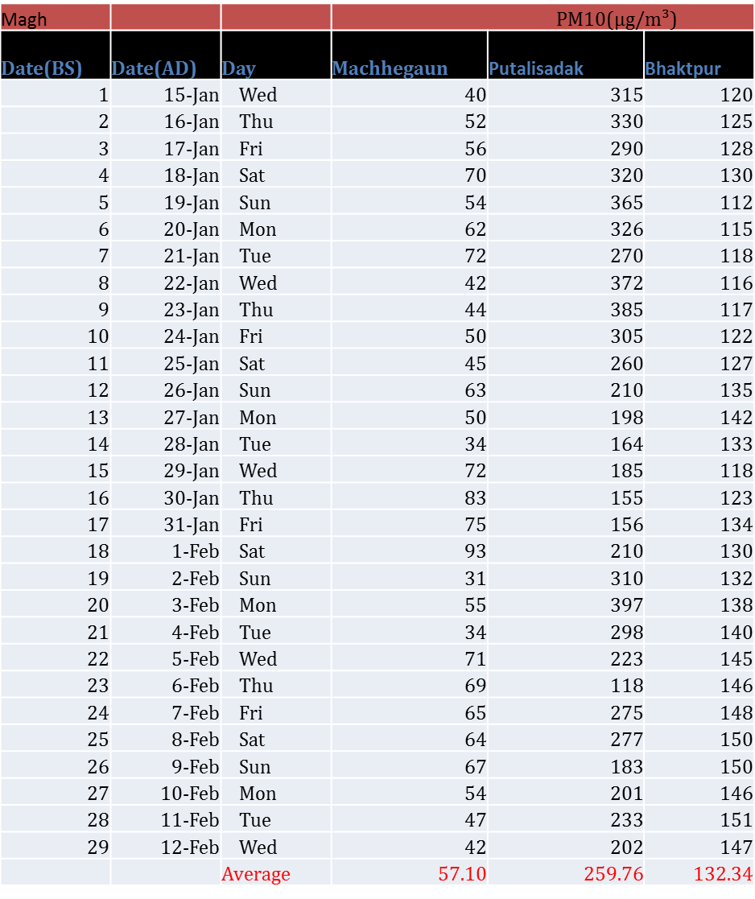

Slide 28
Pollutant concentration level(2070 B.S)
 | Putalisadak | Bhaktapur | Matsyagaon
Mangsir | 360.83 | 86.73 | 20.73
Poush | 282.3 | 128.8 | 42
Magh | 259.76 | 132.34 | 52.1

Slide 29
Discussion
Concentration of pollutants increases in winter season
Concentration of Particulate matter was found maximum in Putalisadak and minimum in Machhegaun
Same was the condition with other pollutants
The above condition was due to heavy traffic, unmanaged urbanization,high population density in Putalisadak area and the opposite case in Machhegaun

Slide 30
Concentration at Putalisadak above NAAQS, Nepal whereas well below NAAQS at Machhegaun
Need of urgency to control air pollutants to keep them below background level
Quick actions should be taken otherwise harmful effects in living environment

Slide 31
Recommendations
Proper urbanization
Control of heavy traffic
Development of Green belt area
Ban of old vehicles
Employment of economically viable pollution control technologies
Promotion of electric vehicles
Public awareness programmes
Regular maintenance of air monitoring stations

Slide 32
Reference
www.adb.org
www.weikipedia.org
www.hierarchystructure.com
www.britannica.com/technology/solid-waste-management

Slide 33
Thank you

Slide 34
A presentation on waste water treatment in Kathmandu
Submitted to:
Asso. Prof Dr Nawaraj Bhattarai
Department of mechanical engineering
Presented by:
Dipesh Budhathoki
(070 bme 616)

Slide 35
Wastewater Treatment in Kathmandu
Introduction
60% households wastes directly connected with sewer lines
Direct disposal of households wastes in rivers
800m3 /day of waste water productions from 50.9% industries in Kathmandu
350 MLD of wastewater productions

Slide 36
Wastewater Treatment in Kathmandu
2. Existing wastewater treatment plants
Plant | Type | Reported Capacity (in MLD) | Status
Guheswori | Activated sludge plant | 17.3 | Operating
Hanumanghat | Aerated lagoons | 0.5 | Not operating
Sallaghari | Aerated lagoons | 2 | Not operating
Kodku | Non-aerated lagoons | 1.1 | Partially operating
Dhobighat | Non-aerated lagoons | 15.4 | Not operating

Slide 37
Wastewater Treatment in Kathmandu
3. Major pollutants
Oxygen Demanding Wastes
Disease-causing Agents
Synthetic Organic Compounds
Plant Nutrients
Inorganic Chemicals and Minerals
Sediments
Thermal Discharges

Slide 38
Wastewater Treatment in Kathmandu
4. Importance
Prevention of water-borne diseases like cholera , dysentery, typhoid, etc.
Preservation of aquatic eco-system
Prevention of lead poisoning , foul smell, discomfort, etc.

Slide 39
Methodology
Industrial waste water treatment
Septic tank
Ozone wastewater treatment
De-nitrification

Slide 40
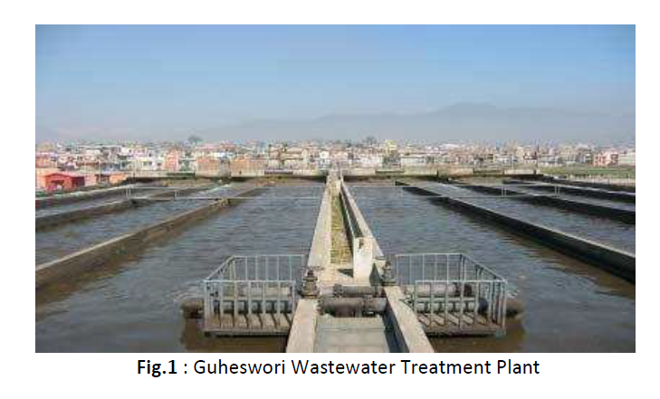
Wastewater Treatment in Kathmandu
6. Guheswori Wastewater Treatment Plant (GWWTP)
Location:
At the bank of Bagmati river (North-eastern part of Kathmandu)
Treatment of wastewater from Gokarna, Chabahil, etc.
Activated sludge type plant
Reported capacity: 17.4 MLD

Slide 41
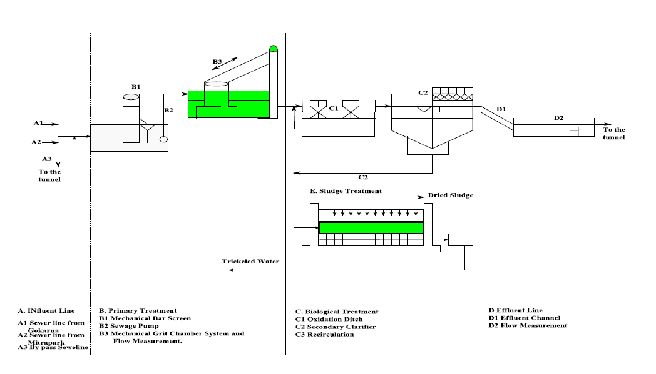
Wastewater Treatment in Kathmandu
7. Plant Layout

Slide 42
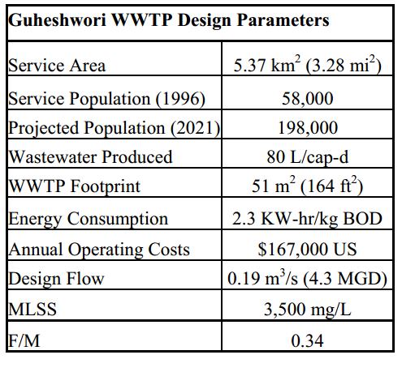
Wastewater Treatment in Kathmandu
8. General Design Parameters of GWWTP
A. Design paraemeters

Slide 43
Wastewater Treatment in Kathmandu
8. General Design Parameters of GWWTP
B. Oxidation Ditch
Carrousel type oxidation ditch (80mx20m)= 2 units
Capacity, m3 =10400
Hydraulic Residence Time (HRT,) hr =15.2
Total Oxygen Demand, kg/hr =355
Mixed Liquor Suspended Solid Concentration, mg/L =3500
Food/Microorganisms (F/M) =0.34
Re-circulation Demand, % =67-100
Power Required to Drive Aerator, kWh =375

Slide 44
Wastewater Treatment in Kathmandu
8. General Design Parameters of GWWTP
C. Secondary clarifier
Diameter of 27m =2 units
Capacity =1650 m³
Hydraulic Residence Time (HRT) =4.8 hr
Drying Beds (27m x 74m)= 2 units
Drying Period= 2-3 weeks
Sludge Production= 40 m³/d
Grit and Sand= 3 m³/d
Screenings= 2-3 m³/d

Slide 45
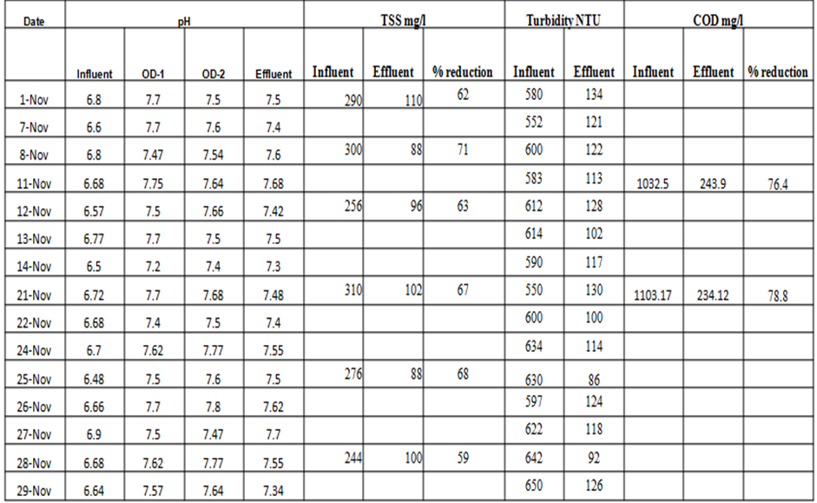
Wastewater Treatment in Kathmandu
9. Data collection
A. For the month of November

Slide 46
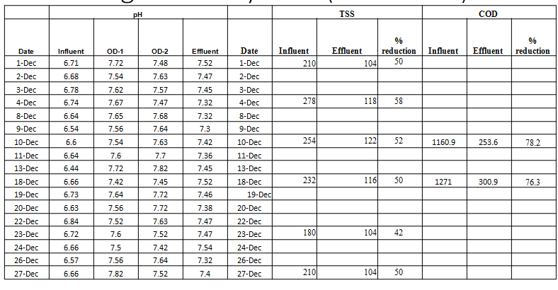
Wastewater Treatment in Kathmandu
9. Data collection
B. For the month of December

Slide 47
Wastewater Treatment in Kathmandu
10. Results
For November:
77% reduction in COD
65% reduction in TSS
For December:
77% reduction in COD
50% reduction in TSS

Slide 48
Wastewater Treatment in Kathmandu
11. Conclusion and Recommendations
Management of households and industrial wastes
Establishment of disposal sites
Establishment of decentralized treatment facilities (industries, hospitals ,etc)
Source management

Slide 49
THANK YOU

